Slide 1
The Speed Dating Experiment
Jose Reyes
02/01/2018

Slide 2
Introduction

Slide 3
The Modern-day Dating
There’s a plethora of web-based dating apps!
Various dating apps/services:
Personality-based online dating: Match.com and eHarmony.com
Location-based apps: Happn, OkCupid, and Tinder
Online/Real-life Hybrid: Match.com/Speed-Dating Events.

Slide 4
Modern-Day Dating (con’t)
Why such apps exist:
Convenient way to meet people.
Plenty of options!
Search potential mates based on like-minded preferences.
Dating App Short-comings:
Profiles are often inactive.
Strictly a numbers game!
Other attractive attributes not able to be communicated in a profile can be overlooked.

Slide 5
The Solution: Speed-Dating!
If we can analyze participant ratings/preferences in a speed-dating event we can :
Identify the key factors that makes a man/woman attractive.
Provide guidance how to improve attractive factors for dating success
Predict whether a speed-dating match!
Using Python and the Speed Dating dataset from the Kaggle website, we will aim to predict whether a female speed-dating partner would like to see the male partner again!

Slide 6
The Dataset

Slide 7
Dataset Inspection
Dataset contains 195 columns and 8,378 observations
Collection of ratings from 4-minute dating encounters over twenty-one speed dating events, held between Oct. 2002 and April. 2004.
Participants are a mix of graduate and undergraduate students/faculty from Columbia University.
551 participants: 274 men & 277 women.

Slide 8
Data Wrangling

Slide 9
Initial Data Quality Findings
Relatively clean dataset with minor exceptions:
Missing values in columns of interest.
Duplicate data: same speed-date encounter from two perspectives, male and female.
Binary data not binary in columns of interest. No explanation provided.

Slide 10
Data Wrangling
Original dataframe
Revised dataframe
195 columns and 8,378 rows.
Missing data in key columns.
Incorrect Binary values
35 columns and 4,184 rows.
Imputed with most freq. value.
Corrected to true binary values.

Slide 11
The Participants

Slide 12
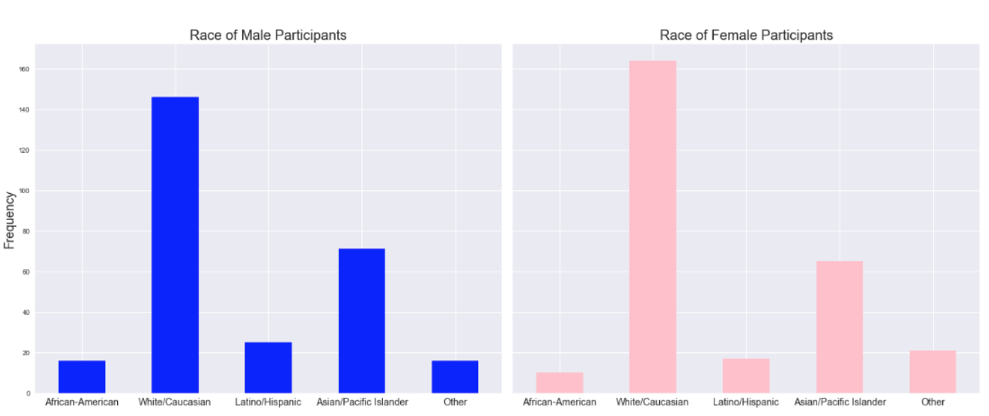
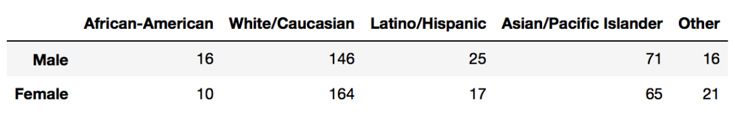
Participant Demographics

Slide 13
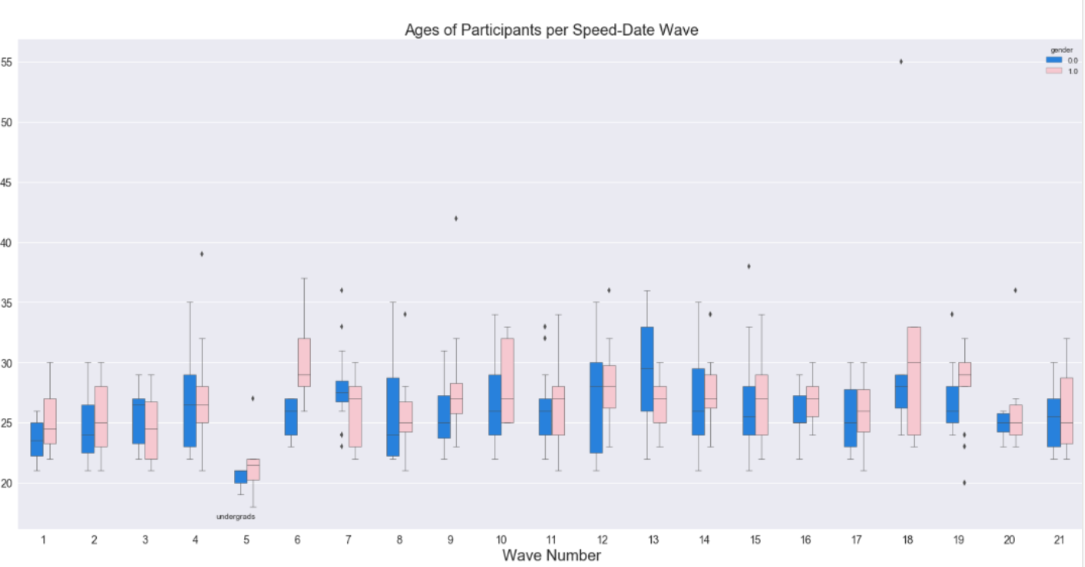
Participant Demographics (con’t)

Slide 14
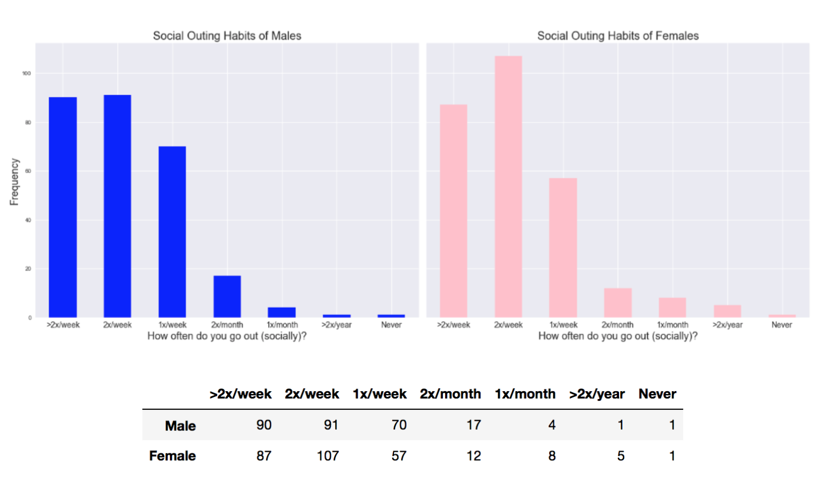
Participant Social/Dating Habits (con’t)

Slide 15
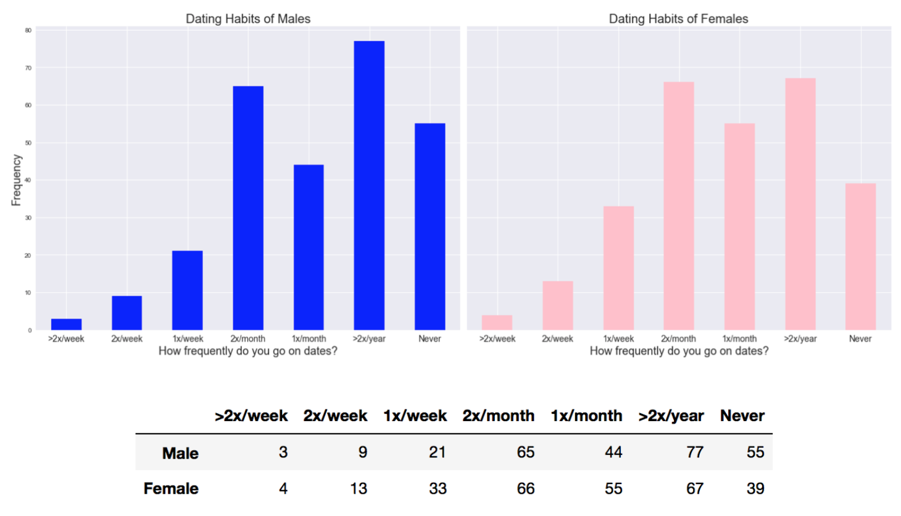
Participant Social/Dating Habits (con’t)

Slide 16
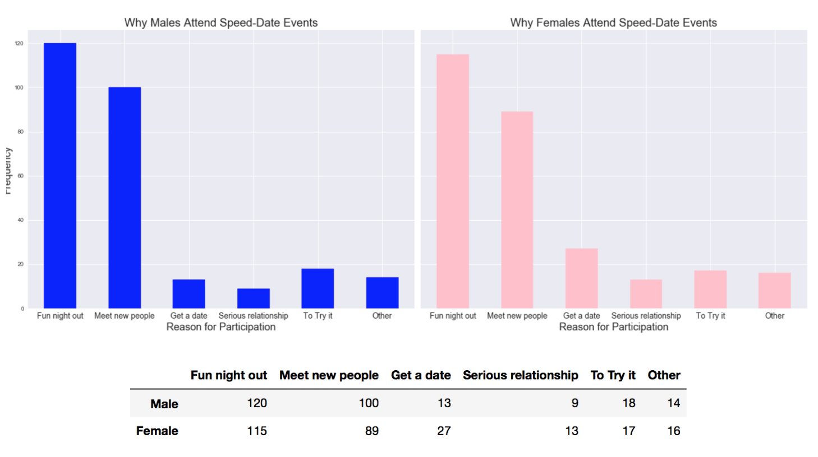
Participant Participation Purpose

Slide 17
Summary: The typical participant
26-years old
Caucasian
Inversely proportional dating/social habits: goes out often, infrequently dates.
Participation in speed-dating event is purely recreational.

Slide 18
Inferential Statistics

Slide 19
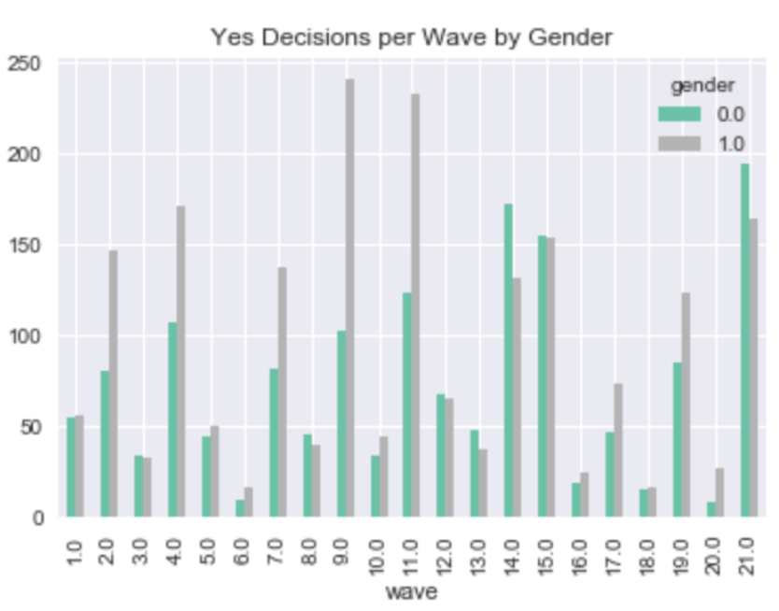
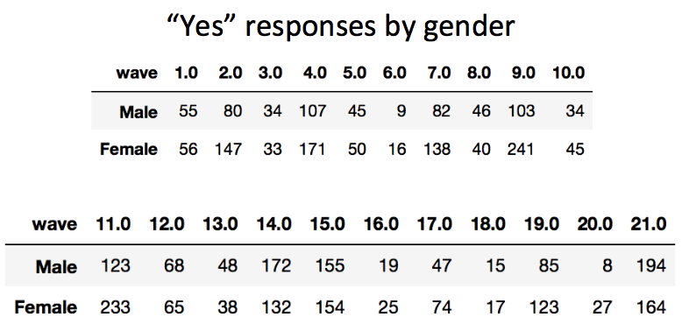
Participant “Yes” responses per event

Slide 20
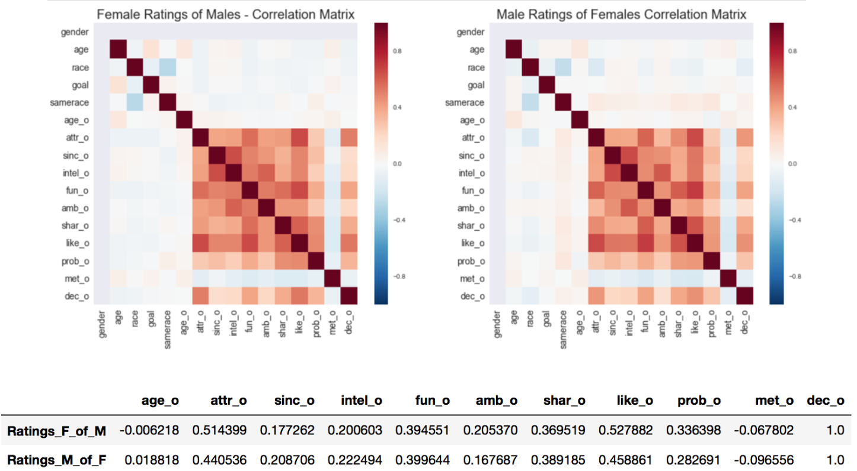
Correlation Studies

Slide 21
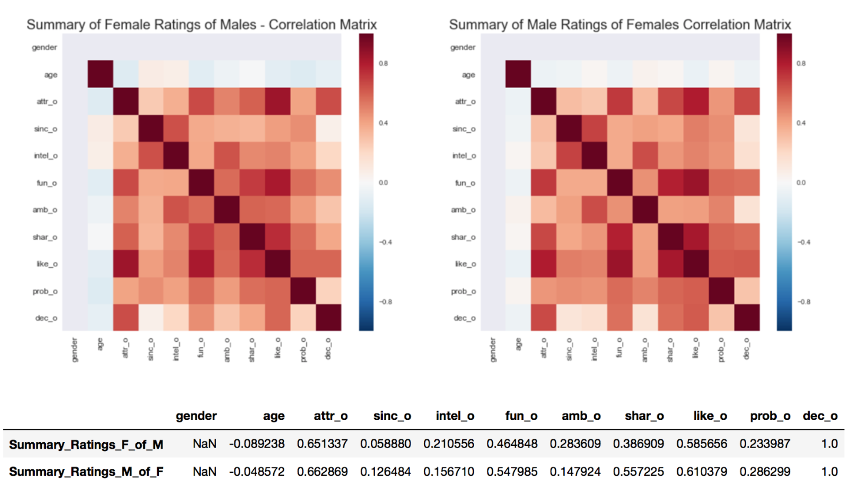
Correlation Studies (con’t)

Slide 22
Building the Algorithm

Slide 23
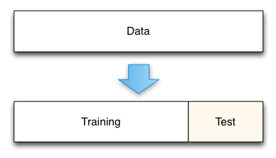
Training/Testing Set Creation
Utilized Python’s Scikit-Learn machine learning library.
Dataset was split into striated training and testing sets:
Training set = 80% of data
Testing set = 20% of data
Target variable: ”yes” partner response.
Features: Speed-Date Questionnaire ratings.

Slide 24
Results
Algorithm | Best Test Score
Decision Tree | 78.14%
Gradient Boosted Decision Tree | 82.32%*
Random Forest | 82.20%
Logistic Regression | 80.41% (AUC = .8039)
Logistic Regression w/ Standard Scaler | 80.53% (AUC = .8053)
Logistics Regression w/ Standard Scaler & less features | 80.65% (AUC = .8064)
Logistics Regression w/ Standard Scaler & top 3 features. | 76.70% (AUC = .7675)
Each algorithm was trained using the training set.
Each algorithm was fitted to the testing set to assess model performance.
Each algorithm was fine-tuned to improve performance.

Slide 25
Discussion/Recommendations

Slide 26
Discussion
The best performing algorithm was the Gradient Boosted Decision Tree. It performed the best in predicting a “yes” response from a female participant.
A score of 82.32% is decent, but preferable if 90% or above.

Slide 27
Recommendations
Use additional data found in the dataset, namely hobbies/interests. Do people with shared interests correlate with a positive match?
Collect additional data, namely a transcript of each 4-minute conversation for Natural Language Processing. Can language predict a match?
Collect non-invasive thermal imaging data to assess the genuiness of a “yes” response. Can biological indicators predict a “yes” response?
Utilize more sophisticated predictive techniques (Deep Learning/Neural Networks).

Slide 28
Questions?

